Slide 1


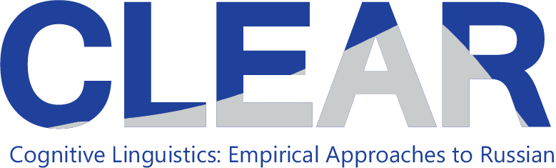
Strategic learning of Russian through cooperation

Slide 2
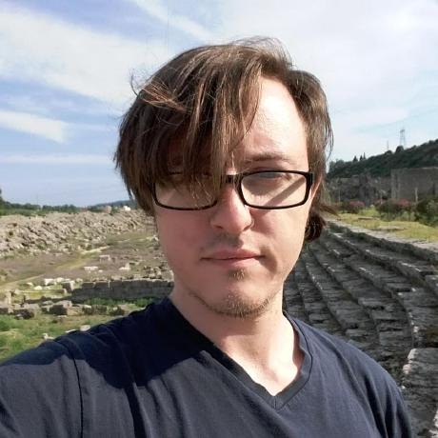
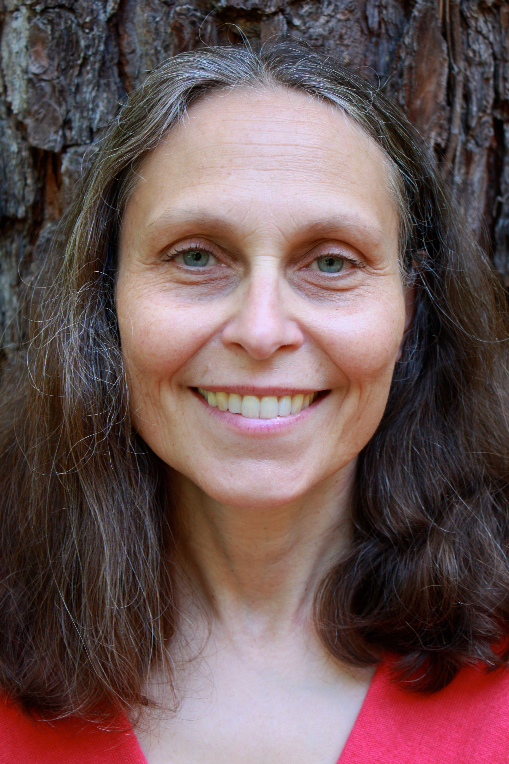
Laura A. Janda
Tore Nesset
Svetlana sokolova
Ekaterina Rakhilina
Olga Lyashevskaya
Francis M. Tyers

Slide 3
TWIRLL: Targeting Wordforms in Russian Language Learning
Joint project of UiT and HSE
Funded by Senter for Internasjonalisering av Utdanning (SIU) / Norwegian Centre for International Cooperation in Education 2018-2020
Objectives:
SMARTool: Strategic Mastery of Russian Tool
Revision of course curricula, double degree programs at MA and PhD level
Student and staff mobility

Slide 4
Previous joint projects of UiT and hse
2012, 2014, 2016: Rakhilina & Lyashevskaya at UiT, Janda & Nesset HSE
2015-2016: SIU-funded Varangian Rus’ project
Student mobility every semester since Spring 2014, funded by SIU
Numerous joint publications of UiT & HSE faculty
2011-2012: Joint research funded by Centre for Advanced Study at the Norwegian Academy of Science and Letters “Time is Space: Unconscious Models and Conscious Acts”
Ongoing project: Russian Constructicon https://spraakbanken.gu.se/karp/#?mode=konstruktikon-rus

Slide 5
Rationale behind the SMARTool
Research presented in
Janda, Laura A. and Francis M. Tyers. 2018. “Less is More: Why All Paradigms are Defective, and Why that is a Good Thing”. Corpus Linguistics and Linguistic Theory 14(2), 33pp. doi.org/10.1515/cllt-2018-0031.
Based on
corpus data (SynTagRus)
computational experiment modeling learning of Russian wordforms

Slide 6
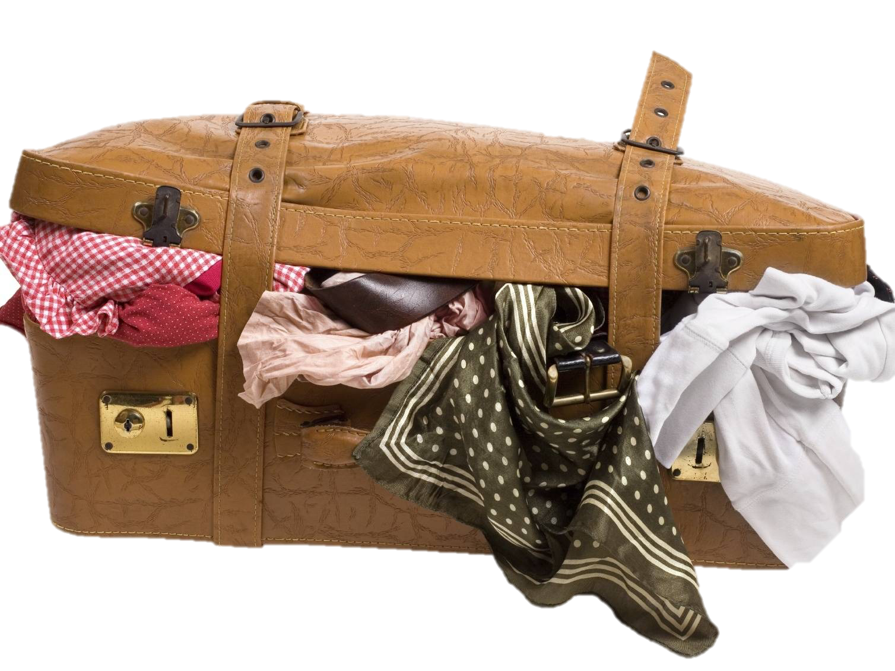
Why our language textbooks are like overstuffed suitcases
Only 3 or fewer forms constitute most of the frequency of a typical lexeme; all other forms are rare or unattested
In our learning experiment, a computational model trained only on the single most frequent form of each lexeme consistently performed better than a model trained on all forms of each lexeme

Slide 7
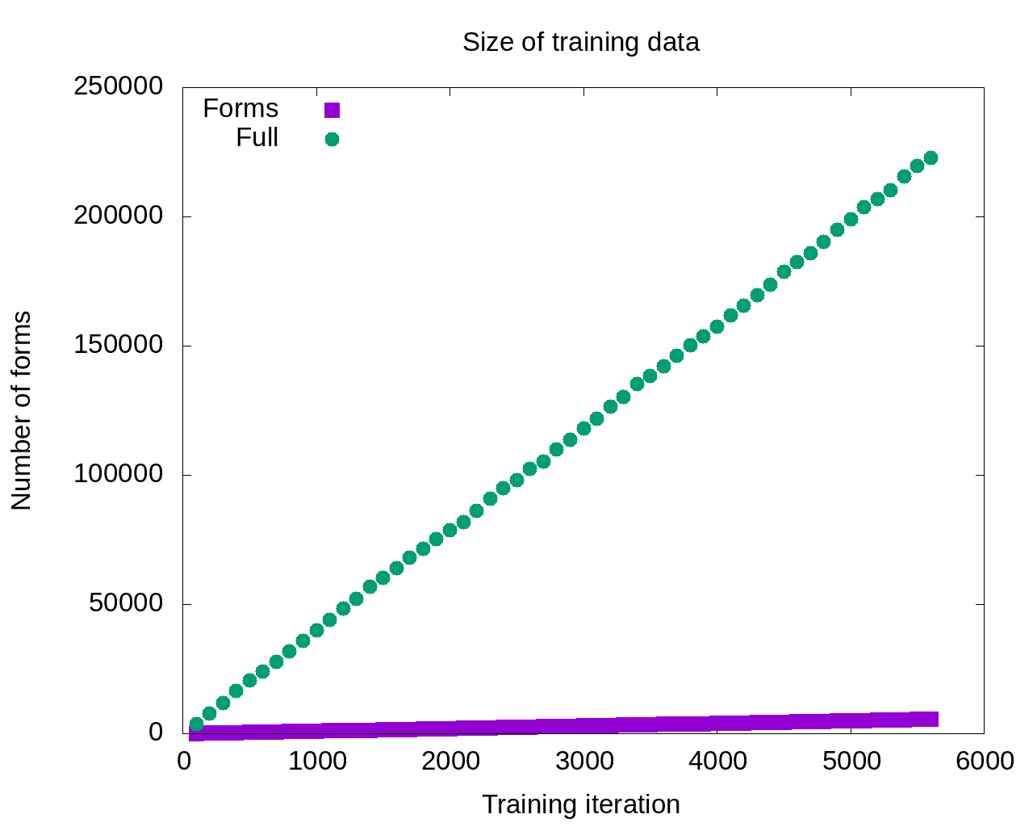

Slide 8
The model that gets the most input should be the most successful, right?

Slide 9

Maybe not…

Slide 10
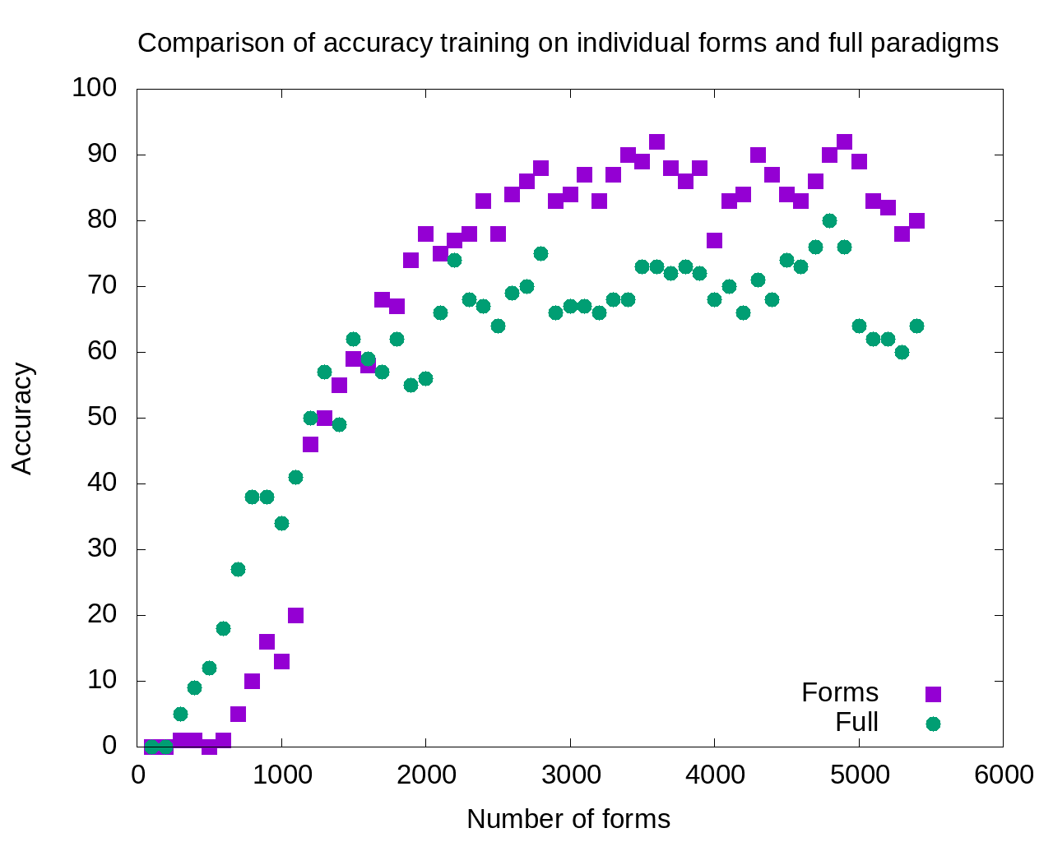

Slide 11
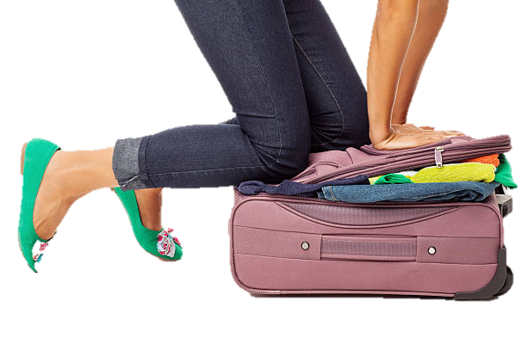
Excess data is probably overpopulating the search domain

Slide 12
The SMARTool: an internet resource
The Strategic Mastery of Russian Tool puts learners and instructors in contact with all and only the wordforms that they need most.
The user can browse over 3000 Russian words according to proficiency level, topic, textbook, and grammatical categories.
For each word, the SMARTool provides the three most common forms, plus example sentences that show how those forms are used.

Slide 13
The SMARTool Teams
TWIRLL collaborators:
Laura Janda, Tore Nesset, Svetlana Sokolova (UiT)
Ekaterina Rakhilina, Olga Lyashevskaya, Francis M. Tyers (HSE)
Mikhail Kopotev, U Helsinki
Student workers in Moscow (HSE)
Valentina Zhukova, Evgenia Sudarikova, Elizaveta Sazonova
Website Design
Radovan Bast (UiT)

Slide 14
SMARTool Tasks and progress thus far
Task | Team/Member | Status
Select 500 lexemes each for levels A1-A2, 1000 lexemes each for levels B1-B2 | TWIRLL collaborators | Completed
Database of 3 most frequent forms for lexemes | Tyers | Completed
Design of extended database (Topics and other parameters) | TWIRLL collaborators | Completed
Supplying examples, filling in glosses and Topics | Student workers, Janda | In Process
Design of website interface | Bast | Prototype stage

Slide 15
